Slide 1
ARCADIS DATA SCIENCE PROBLEM
15 MARCH 2022
ARNAV JAITLY

Slide 2

EXPLORATORY DATA ANALYSIS
Aspects
Structural
Quality
Outliers

Slide 3
EXPLORATORY DATA ANALYSIS
Part 1 - Structural Investigation
Data Types
Data Shape
JOB_ID object
JOB_TYPE object
DEPTH_M float64
DIAMETER_MM int64
MATERIAL object
LENGTH_M float64
JOB_COST float64
dtype: object_________
ROWS | COLUMNS
5000 | 7

Slide 4
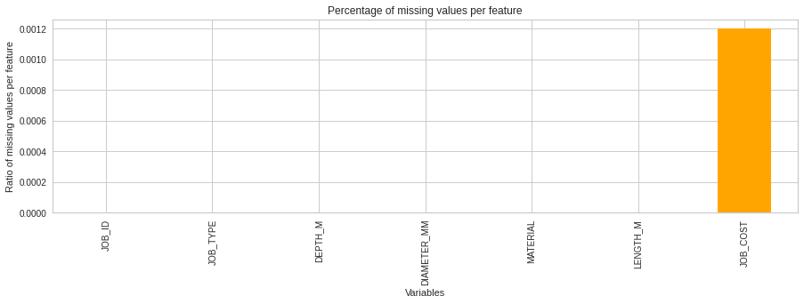
EXPLORATORY DATA ANALYSIS
Part 2 - Quality Investigation
Checking for missing values
Dealing methodology - Interpolation
JOB_ID False
JOB_TYPE False
DEPTH_M False
DIAMETER_MM False
MATERIAL False
LENGTH_M False
JOB_COST True
dtype: bool_________
Fig - Percentage of missing values per feature

Slide 5
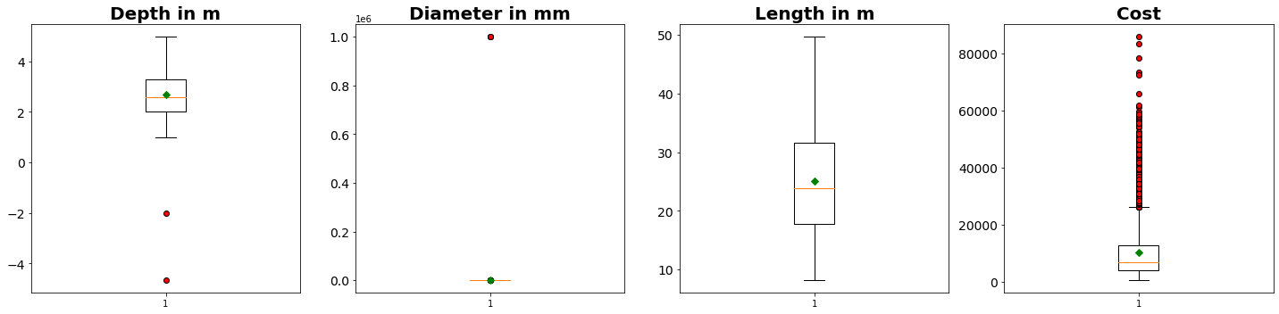
EXPLORATORY DATA ANALYSIS
Part 3 - Outliers
Task - Remove negative values of Depth and excessively large values of Diameter
Approach - Filter using Inter-quantile Range

Slide 6
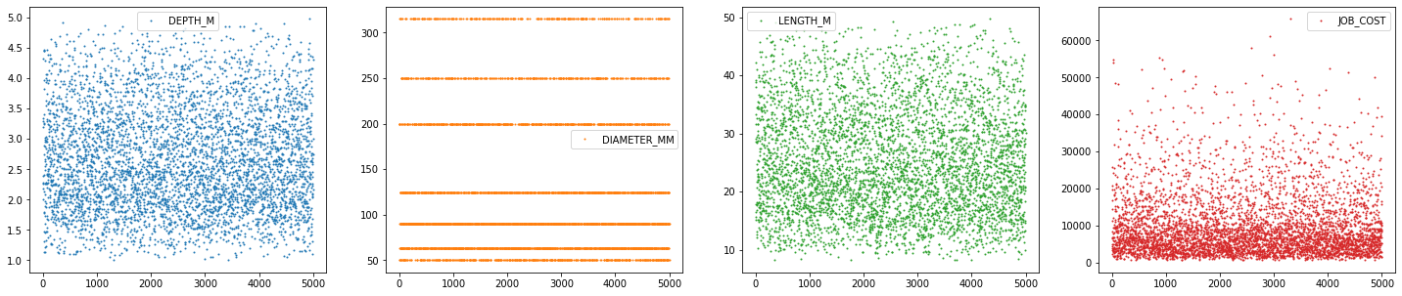
VISUALIZING THE NUMERIC DATA

Slide 7
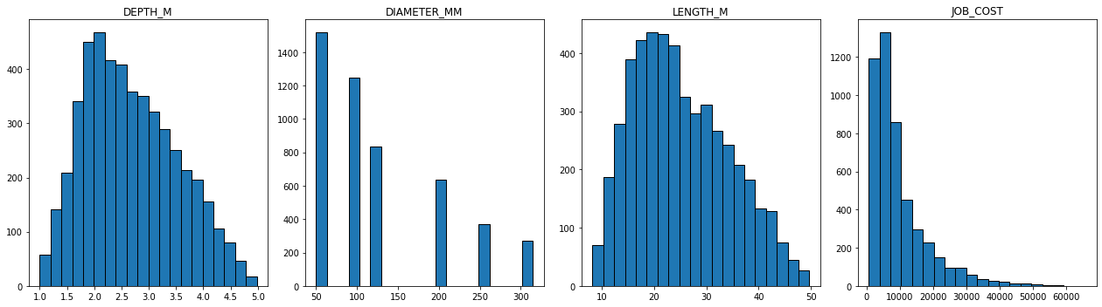
VISUALIZING THE NUMERIC DATA

Slide 8
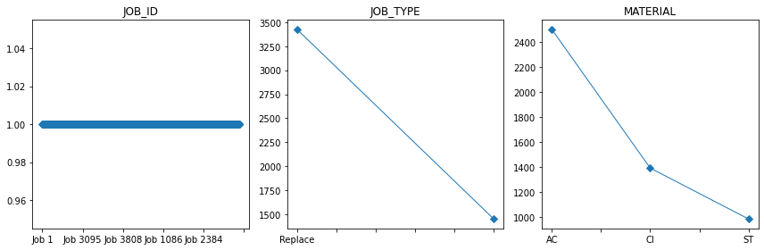
VISUALIZING THE NON- NUMERIC DATA

Slide 9
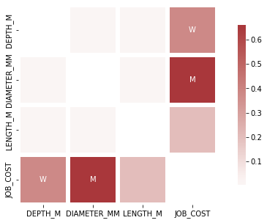
FEATURE CORRELATIONS
GOOD CORRELATION BETWEEN COST AND DIAMETER
WEAK CORRELATION BETWEEN DEPTH AND COST
NEGLIGIBLE CORRELATION BETWEEN COST AND LENGTH

Slide 10
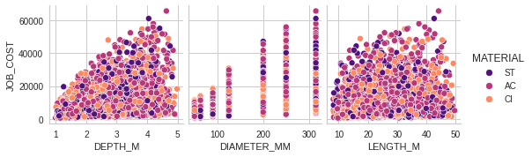
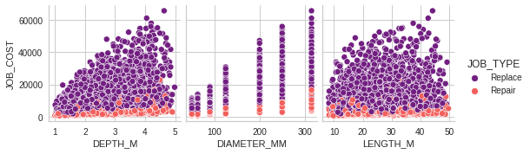
FEATURE CORRELATIONS

Slide 11
SIMPLE LINEAR REGRESSION
Aspects
Data Extraction
Converting Dummy Variables
Splitting Data
Building and Evaluation

Slide 12
REGRESSION METRICS
LINE OF BEST FIT
METRICS
Intercept: -15690.006191812221
Coefficients:
'DEPTH_M', 3695.3269466941993),
'DIAMETER_MM', 77.26852170227278),
'LENGTH_M', 166.48835152906605),
'MATERIAL_AC', -62.33470891387692),
'MATERIAL_CI', 11.908251123274326),
'MATERIAL_ST', 50.426457790601916),
'JOB_TYPE_Repair', -3866.9326817654837),
'JOB_TYPE_Replace', 3866.9326817654837)]
R squared: 81.99
Mean Absolute Error: 2582.33
Mean Square Error: 15787944.89
Root Mean Square Error: 3973.40

Slide 13
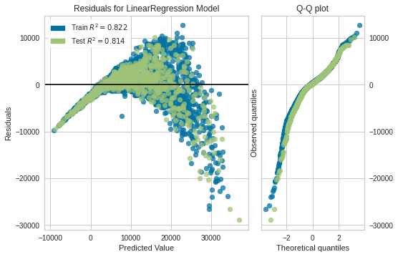
RESIDUAL PLOTS

Slide 14
PREDICTION WITH NEURAL NETWORK
Aspects
Model Layers
Loss Function & Optimizer
Callbacks

Slide 15
REGRESSION METRICS
MODEL SUMMARY
MODEL OUTCOME
Model: "sequential"
___________________________________________________
Layer (type) Output Shape Param #
===================================================
dense (Dense) (None, 64) 576
dense_1 (Dense) (None, 64) 4160
dense_2 (Dense) (None, 1) 65
===================================================
Total params: 4,801
Trainable params: 4,801
Non-trainable params: 0
Testing set mean absolute error: 892.692
This implies that for each prediction the actual answer was off by approximately 892.7
This is a much better result as opposed to a simple linear regression

Slide 16
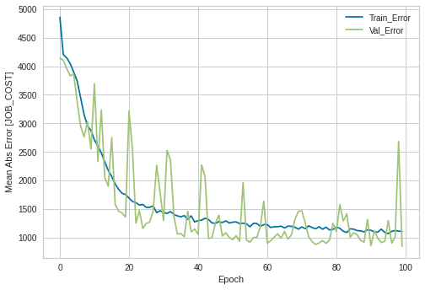
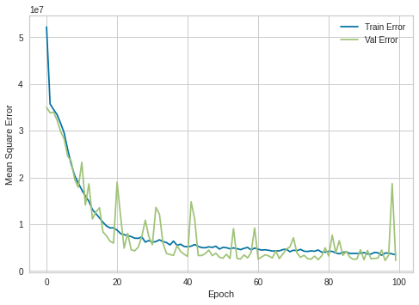
TRAINING AND TESTING LOSS

Slide 17
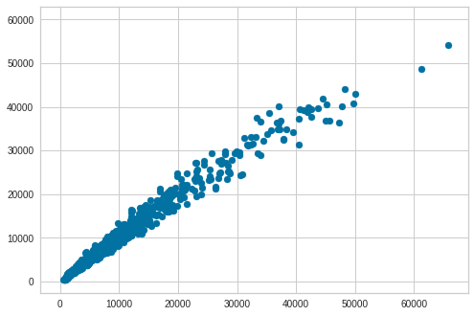
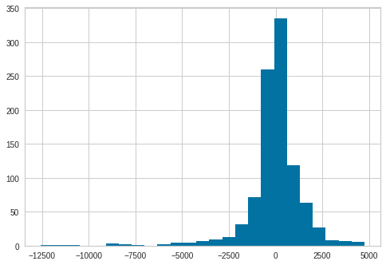
MODEL PREDICTIONS AND ERROR
STRAIGHT LINE
NORMAL DISTRIBUTION

